Slide 1
Java Basics Summary

Slide 2
What we will NOT cover
How to install Java (Java 8 is required)
What is the difference between JRE and JDK?
What is x64 and x86 or linux/mac/windows
How to install Eclipse, IDEA, Netbeans or J****, it is up to you to decide what you want to use.
How to install any additional editors, tools or software

Slide 3
Variables
name
value
type
int total = 200;

Slide 4
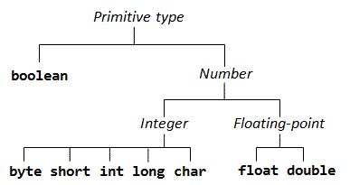
Primitive Types
Primitive types in java
byte, short, int, long
float, double
boolean
char

Slide 5
Primitive Types size
Numeric types are byte, short, long, int, double, float
byte – 8b (-128 : 127)
byte b = 100;
short – 16b (-32768 : 32767 )
short s = 10000;
int – from integer, 32b (-2^31 : 2^31-1)
int i = 10000;
char is used for 16b unicode character
Char values are embedded in ' '
char ch = 'c';
boolean has two values - true or false
boolean bool = false;

Slide 6
Default values
Data type ● byte ● short ● int ● long ● float ● double ● char ● boolean
Default value 0 0 0 0 0.0 0.0 ‘\u0000' false

Slide 7
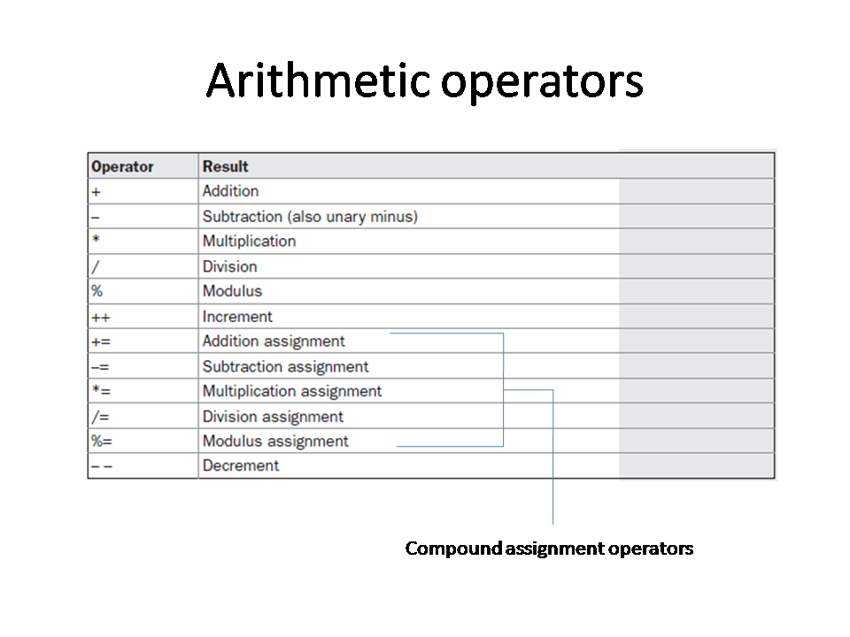

Slide 8
Control Flow
if, else, else if, switch, ?

Slide 9
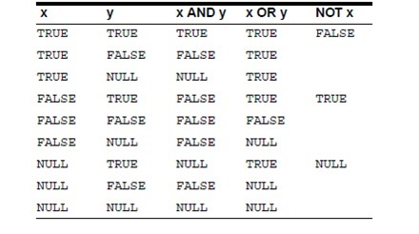
Conditional Statements & Unary Operator
Unary NOT operator !
Conditional AND &&
Conditional OR ||

Slide 10
Arrays

Slide 11
Loops
For, do while, while, *”for each”

Slide 12
Break & Continue

Slide 13
Strings

Slide 14
Object oriented programming
Classes
Fields
Methods
Constructors
Static members
Inheritance
Access modifiers
Interfaces & Abstract classes
Polymorphism
Inner classes, static classes
Upscaling / Downscaling

Slide 15
Exceptions
throwing, catching, writing

Slide 16
Generics

Slide 17
Collections

Slide 18
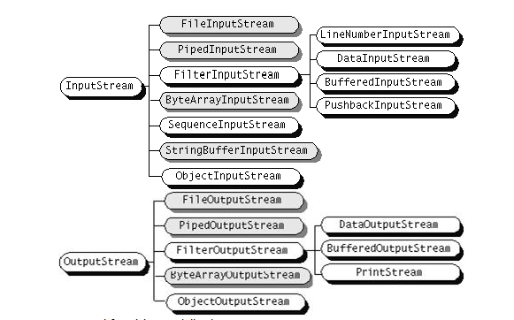
Streams
Binary streams
Text Streams
Files
Serialisation

Slide 19
Swing

Slide 20
Lambdas

Slide 21
Now … the advanced Java course.

